Slide 1
Orientation

Slide 2
Background & History
Department of Revenue (DOR) system previously only allowed certain State agencies to intercept tax refunds.
In 2014 Code of Alabama 1975 Section 40-18-100 and 40-18-103 were amended.
This allowed municipal and county entities to participate in the existing program.
Stipulation of amendment meant local governments had to use either the Alabama League of Municipalities (ALM) or Association of County Commissions of Alabama (ACCA) as their clearinghouse.

Slide 3
What is MIS ?
Municipal Intercept Services (MIS) is only a conduit between participating entities and the Alabama Department of Revenue.
Simply allows for the input of debt data and formats and transmits it to the DOR as per their specifications.
This allows the DOR to attempt to “intercept” an INDIVIDUAL’S State tax refund by matching Social Security Numbers (SSN).
MIS will then handle any successfully intercepted money and disburse those funds back to participate entities.

Slide 4
What MIS is NOT
Municipal Intercept Services (MIS) is NOT a debt collection service or agency.
  All forms of traditional debt collection should be attempted before using MIS.
Municipal Intercept Services (MIS) can NOT validate the accuracy or legality of ANY of the debt information.
  Solely the responsibility of the participating entity.

Slide 5
What does MIS cost?
MIS is provided at ZERO cost to eligible participating entities.
No special software is needed.
  Use a secure web based portal to the MIS system.
MIS collects a $25 processing fee from the DEBTOR for any successful intercept.

Slide 6
The MIS Website
www.alintercept.org
How the process works
MIS Forms and documents:
  Memorandum of Understanding & Agreement
  Participation Form
  Direct Deposit Authorization Form
  Direct Deposit Authorization Change Form
  Sample “Notice of Intercept” Letter
  Appeals Guidelines
Frequently Asked Questions (FAQ) Section
Video Tutorial and User Training Seminars Sections
Login link to access the system once your application is accepted

Slide 7

Step 5
Step 7
Step 1
Step 2
Step 3
Step 6
Step 8
Step 4

Slide 8
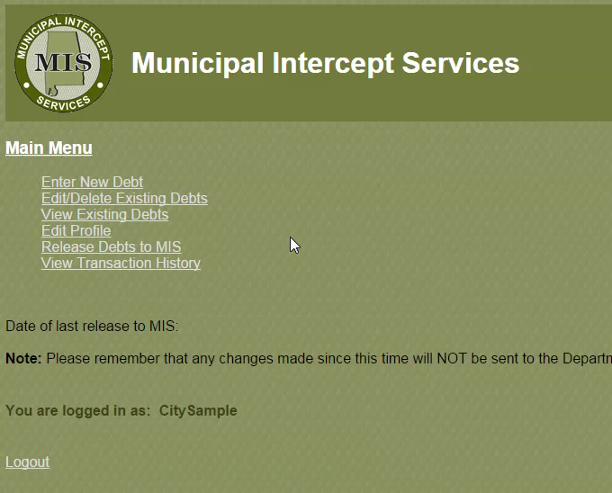
Sample Video
Insert movie showing the input of new debt in the MIS system

Slide 9
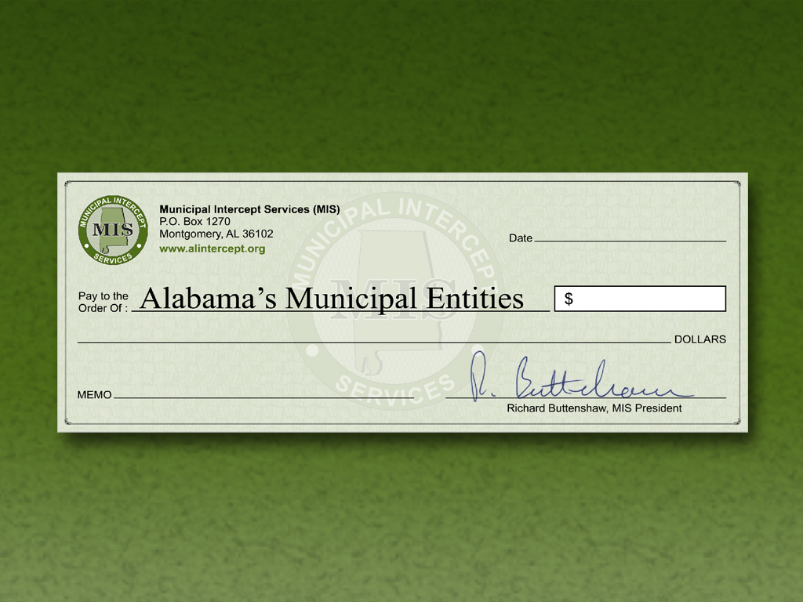
Money recovered for our municipalities so far
May 4, 2017
740,868 ⁹⁹
Seven Hundred Forty Thousand Eight Hundred Sixty Eight and
99
100
114 MIS Members

Slide 10
Resources
More information on the www.alintercept.org website
  FAQ section
  Documents
  Video Tutorials – the videos shown in the User Training
  User Training Seminars (FREE)
    Date and locations
    Online registration
  Contact us
    General Inquiries: recovery@alintercept.org

Slide 11
Questions?

